Slide 1

ELL Leadership Academy
Karina E. Chapa, M.Ed.
Language Proficiency, Biliteracy and Cultural Diversity Director
kchapa@esc1.net
Twitter @esc1bilingual @bilingualpride

Slide 2
Sheltered Instruction
Continuation

Slide 3

RANDOMIZATION TECHNIQUES

Slide 4
Randomization Techniques
Write-Read-Read-Trade
Stand up when you complete in writing one of these sentences:
  I select who I call on by…
  In my classroom, I include randomization because…
  The most beneficial randomization technique I have used is… because…
  Inside-Outside Circle

Slide 5
Randomization Techniques
Is it possible to randomize and differentiate instruction at the same time?
Randomize and rotate who is called on,
so students of all language levels can participate!

Slide 6
Randomization Techniques
Lucky sticks
Beach ball
Index cards
with student names
Class list/roster
Color/numbers
Birthdays
Physical characteristics: longest hair, eye color…
Jenga
Pick up sticks
Career cards
Apps
Popcorn

Slide 7
Total response signals

Slide 8
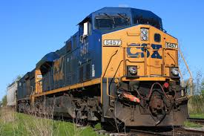
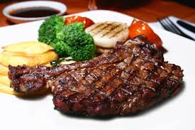
Why is it important to check for understanding along the way?

Slide 9
Written Responses
Hold up paper
White boards
Ready Responses
Hands up when ready
Personal Chalkboards
Answers on cards
Thinker’s chin
Stand up when ready
Put your pen on your paper when ready
All eyes on teacher
Making Choices
Open hand/closed hand
Ranking
Rank with your fingers
Thumbs/Pens up/down
Number wheels
Green card/red card
Move to the corner/spot
Rank with your arm
Line up according to response
Knocking/clapping/
cheering

Slide 10
Find the Fib!
Students may work in pairs or small groups.
Students have three post-its/index cards with the numbers “1, 2, 3” in each card.
Teacher writes 3 statements on the board (one false, two true) and students decide which one is the fib.
On signal from teacher, students show the number of the statement they believe is the fib.

Slide 11
Let’s Play!
Find the Fib
Evaporation is part of the water cycle
Refraction is part of the water cycle
Condensation is part of the water cycle
      I believe number… is a fib because…

Slide 12
Find the Fib
Cognitive and academic development in native language has an important and positive effect on second language acquisition.
Once students can speak English, they are ready to undertake the academic tasks of the mainstream classroom.
According to research, students in ESL-only programs, with no schooling in their native language, take 7-10 years to reach grade level norms.
Let’s Play!

Slide 13
Let’s Play!
Find the Correct Answer
Rhea is a moon of Saturn. Which of these facts about Rhea best indicates that it does not have a water cycle in which water changes state?
A Its radius is 765 km.
B Its density is about 1.3 kg/m3.
C Its period of rotation is about 4.5 Earth days.
D Its temperature is between −174°C and −220°C.

Slide 14
differentiation
Introduction

Slide 15
Review Previous Learning
Write a “Wikipedia” type definition of Sheltered Instruction that you feel clarifies its key intent, elements, and principles – in other words, a definition that could clarify thinking in your school/classroom.
Explain to a teacher new to the field what Sheltered Instruction is in terms of what s/he would be doing in the classroom – and why. The explanation should help the candidate develop a clear picture of what Sheltered Instruction looks like in the classroom.
Develop a metaphor, analogy, or visual symbol – even a logo – that you think represents and clarifies what’s important to understand about the key intent, elements, and principles of Sheltered Instruction.
1
2
3

Slide 16
Next Steps
Move to the area of the room assigned to your number/choice.
In that area of the room, find a partner. Share and compare your work. Then find another partner and share again.
Make sure you discuss similarities and areas of overlap.
When instructed, move into a mixed pair or trio.
In turn, share what your task was and how you responded.
Return to your home tables and identify common points.

Slide 17

Triarchic Teaching - Sternberg
Analytical
Intelligence
Practical
Intelligence
Creative
Intelligence

Slide 18
Which Set of Verbs Appeals to You Most?
Analytical
Analyze, judge, critique, compare, contrast, evaluate, diagram, identify, explain, present a step by step approach, assess.
Practical
Implement, apply, use, demonstrate, teach, put into practice, convince, show how, employ, make practical.
Creative
Invent, discover, imagine, suppose, design, predict, find a new way, create, promote, encourage, develop.
1
2
3

Slide 19
EL Assessments
Accessibility Features and Designated Supports

Slide 20
Session Objectives
Content Objective
Today I will explore different designated supports available for ELs on state assessments.
Language Objective
Today I will share with my peers one designated support and I will listen to their presentations.

Slide 21
STAAR Assessments
STAAR
STAAR
Spanish
(3rd-5th)
STAAR
Alternate
Paper or online
Paper or online
Online

Slide 22
Assessment Accommodations
3. Designated Supports (w/TEA approval)
2. Designated Supports (w/local approval)
1. Accessibility Features (all students)

Slide 23
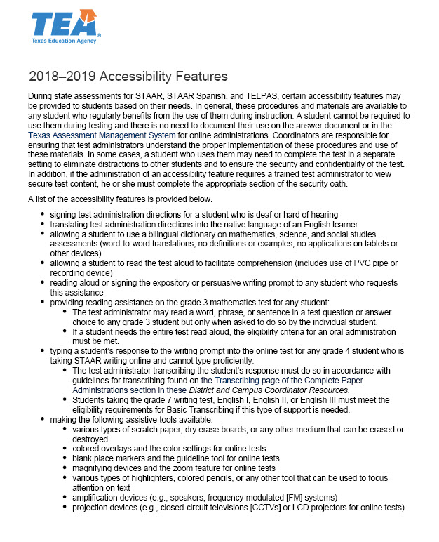
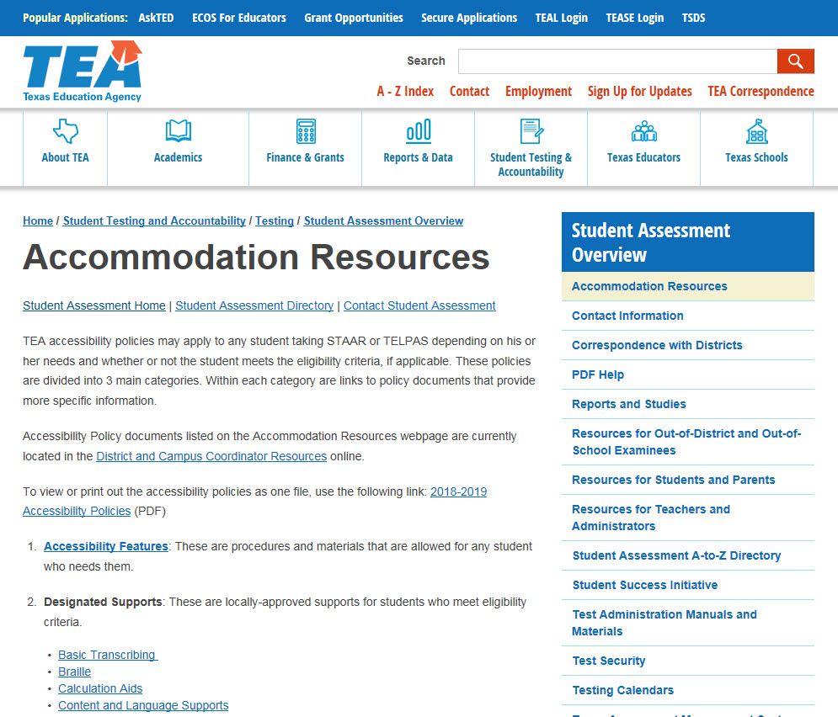
1. Accessibility Features

Slide 24

1. Accessibility Features
#1
…and mingle!
#2
#3
+Back

Slide 25
Assessment Accommodations
3. Designated Supports (w/TEA approval)
2. Designated Supports (w/local approval)
1. Accessibility Features (all students)

Slide 26
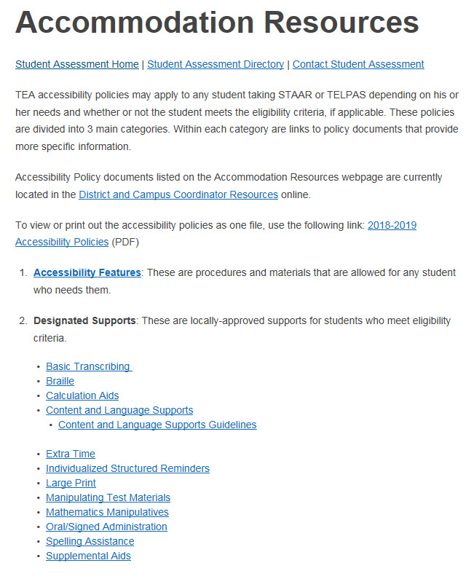
2. Designated Supports
STAAR, STAAR Spanish, and TELPAS accommodations:
  Description
  Assessments
  Student Eligibility Criteria
  Authority for Decision and Required Documentation
  Examples/Types
  Special Instructions/Considerations

Slide 27
2. Designated Supports
Basic Transcribing | Braille | Calculation Aids | Content & Language Supports
Extra Time | Individualized Structured Reminders | Large Print | Manipulating Test Materials
Mathematics Manipulatives | Oral/Signed Administration | Spelling Assistance | Supplemental Aids
OA, content and language supports are embedded in the STAAR online interface.

Slide 28
2. Designated Supports
Extra Time*
Content and Language Supports*
Oral/Signed Administration*
Basic Transcribing
Braille
Calculation Aides
Large Print
Manipulating Test Materials
Mathematics Manipulatives
Individualized Structured Reminders
Spelling Assistance
Supplemental Aids
Some of these designated supports are not new to the assessment program, but are NEW FOR LPACs.
Sometimes these decisions are done in conjunction with other committees.
*If given for R/W, student may not exit LEP status

Slide 29
2. Designated Supports
Extra Time*
Content and Language Supports*
Oral/Signed Administration*
Dictionary Policy
Read assigned text
Create a visual on your Frayer Model
Add 3 bullets with info (no more than 5 words each bullet)
*If given for R/W, student may not exit LEP status
Notes:
Teams of 3.. Name the team… Create a Frayer Model with name of the team in the back
Assign a Designated Support to each person on each team
Group by Designated Support (DS)
Each DS Group will develop a visual and a gesture to explain their DS… Visual at center of Frayer Model
Come back to Teams w names
Each DS explains their visual and gesture and rest of the team fills out one section of their Frayer Model
After each DS is explained, go on with those slides… Then next DS explains, team writes on model and slides cover that section… and so on until all 3 DS are covered.

Slide 30
1. Extra time

Slide 31
Extra Time
Routinely and effectively uses it during classroom instruction and classroom testing;
Unable to effectively use any accessibility features or other designated supports to address this need;
Meets at least one of the other criteria (i.e. student is a current EL).

Slide 32
2. Content and language supports

Slide 33
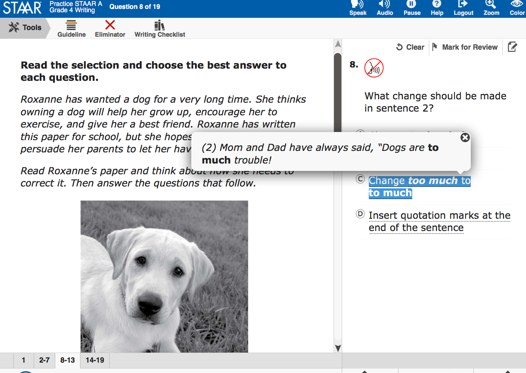
Content and Language Supports
This pop-up isolates information that corresponds to each answer choice.

Slide 34
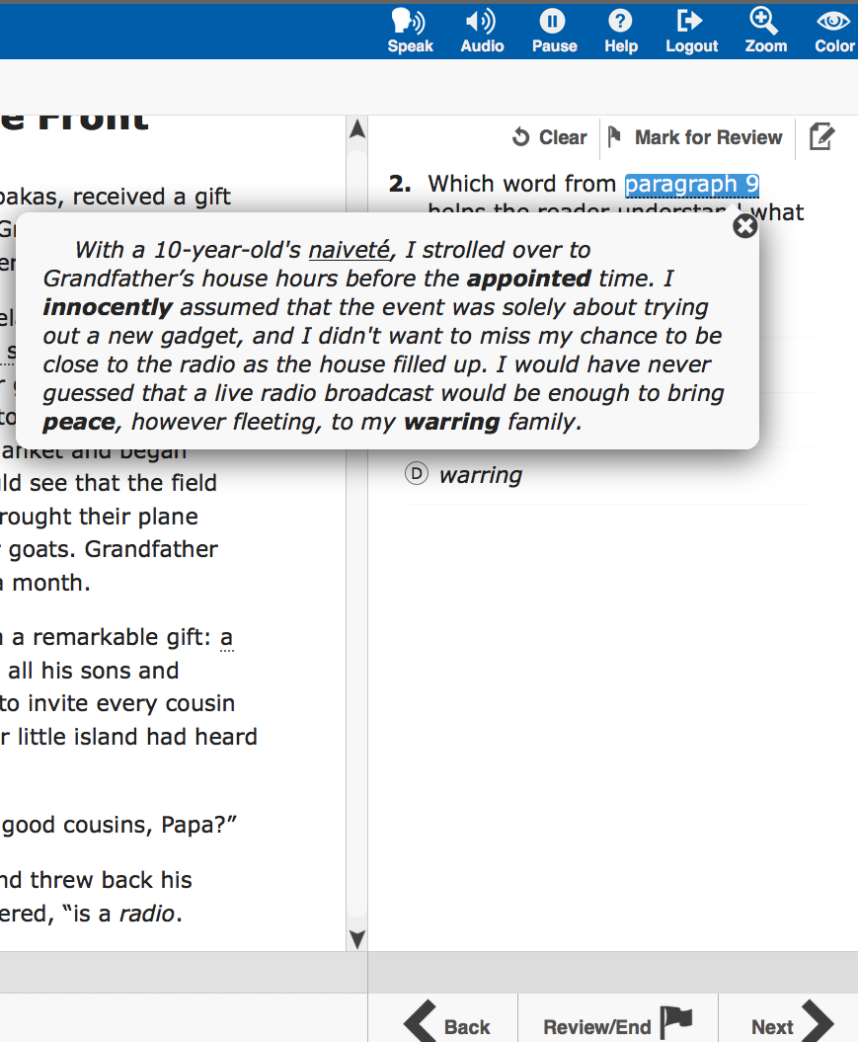
Content and Language Supports
This pop-up also isolates information that corresponds to each answer choice.

Slide 35
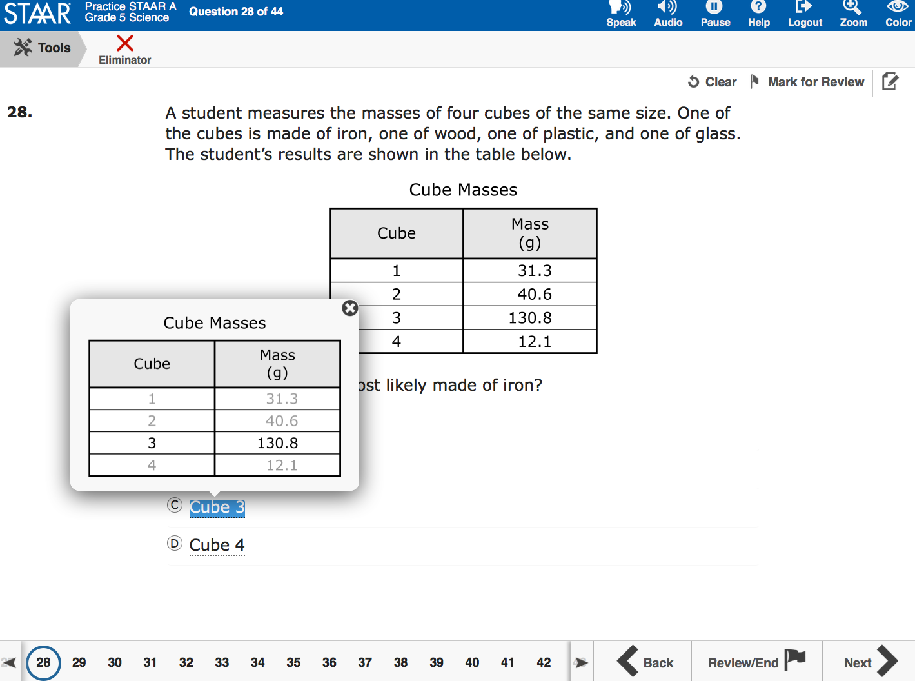
Content and Language Supports
This is another example of a pop-up that isolates information that corresponds to each answer choice.

Slide 36
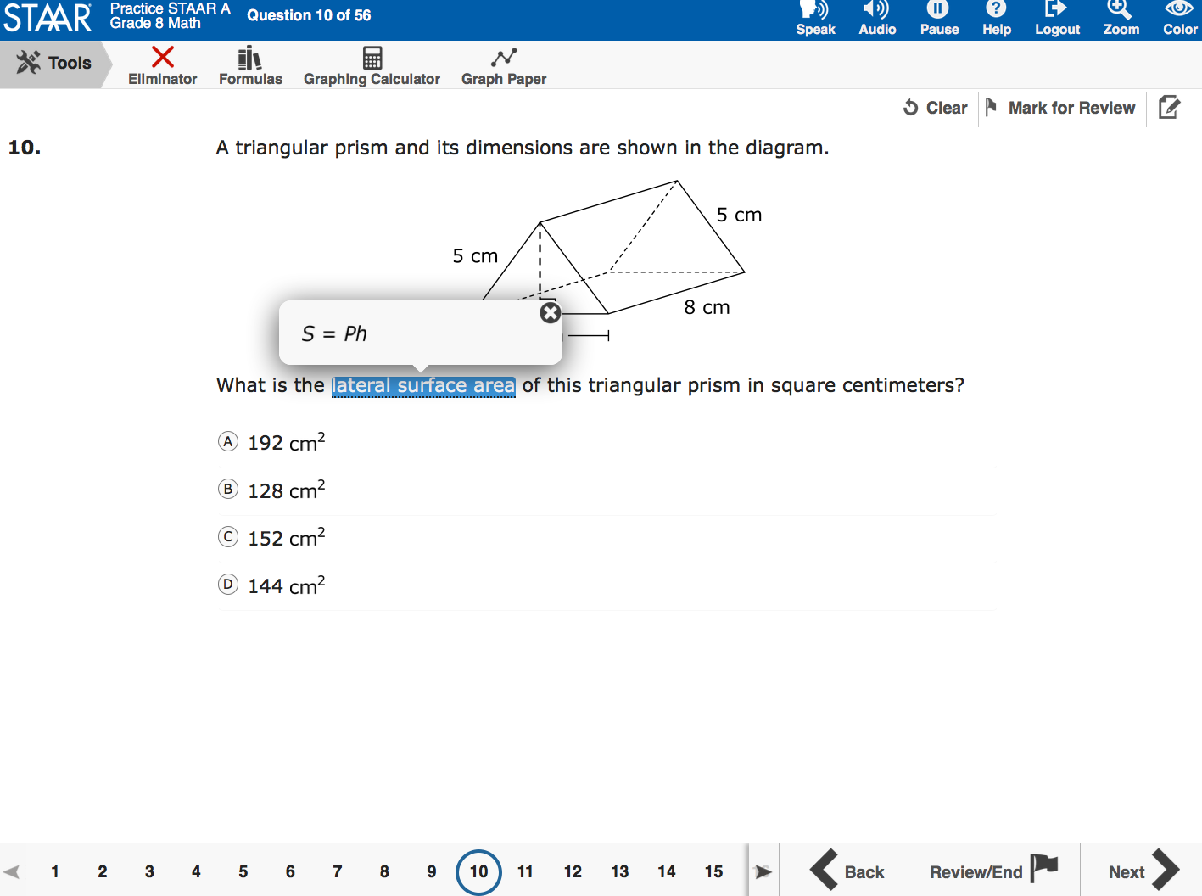
Content and Language Supports
This pop-up provides a formula from the reference material.

Slide 37
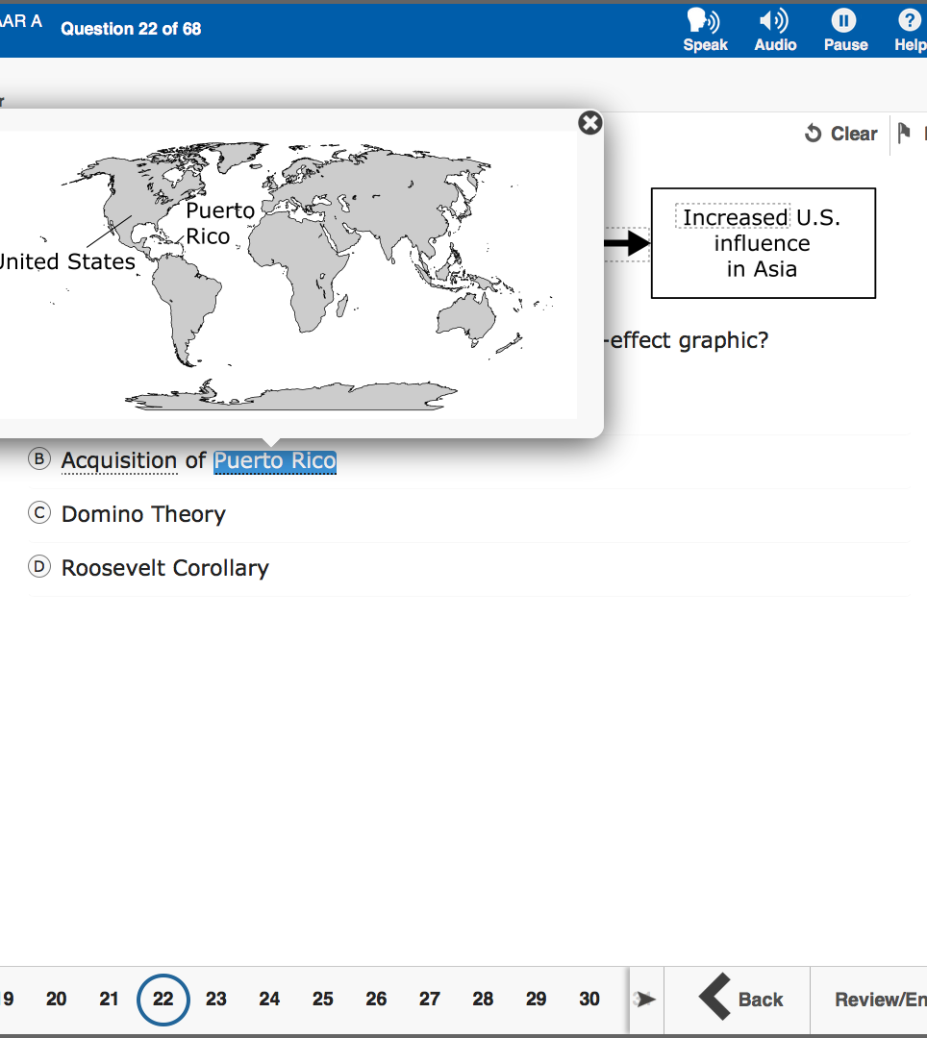
Content and Language Supports
This pop-up provides a supplemental aid
(i.e., map).

Slide 38
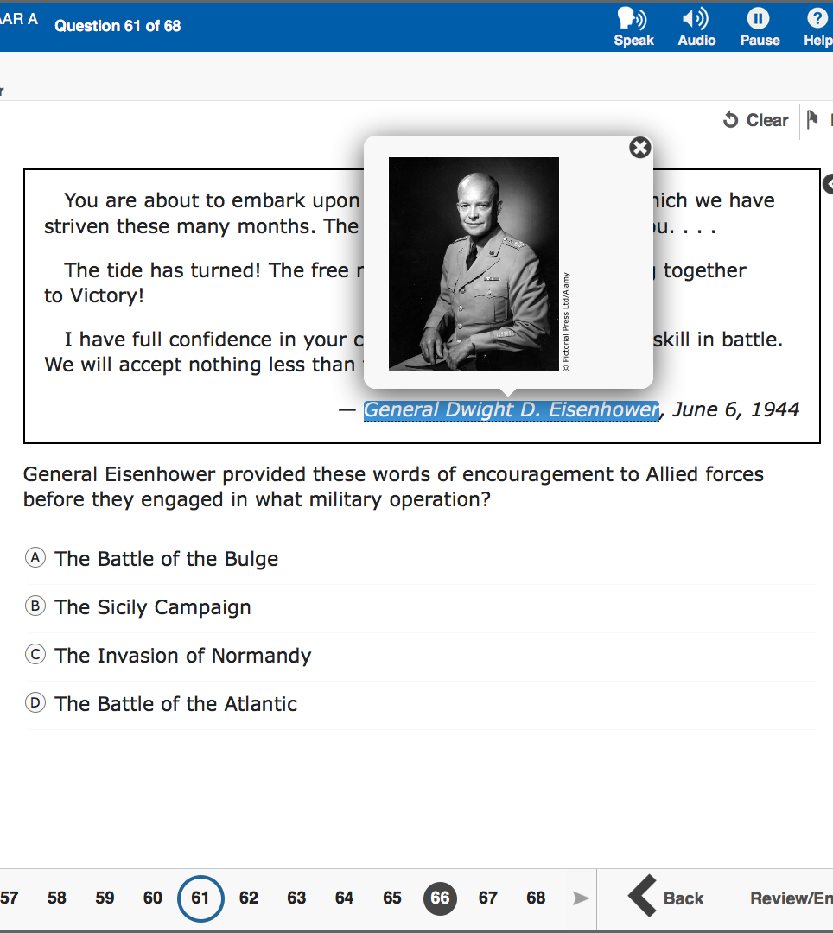
Content and Language Supports
This pop-up provides a visual representation (i.e., photograph) of a historical figure.

Slide 39
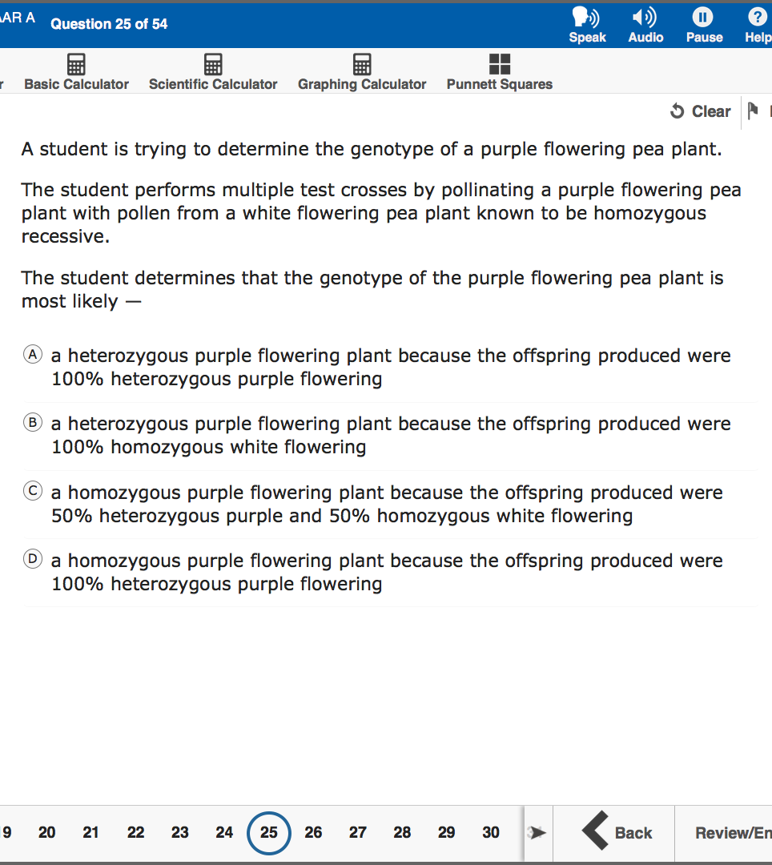
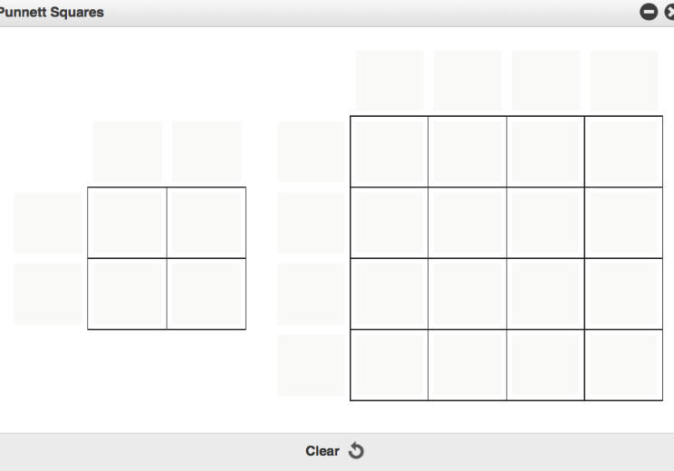
Content and Language Supports
This is a supplementary material. Blank Punnett squares are available for a student to use on STAAR biology with Content Supports.

Slide 40
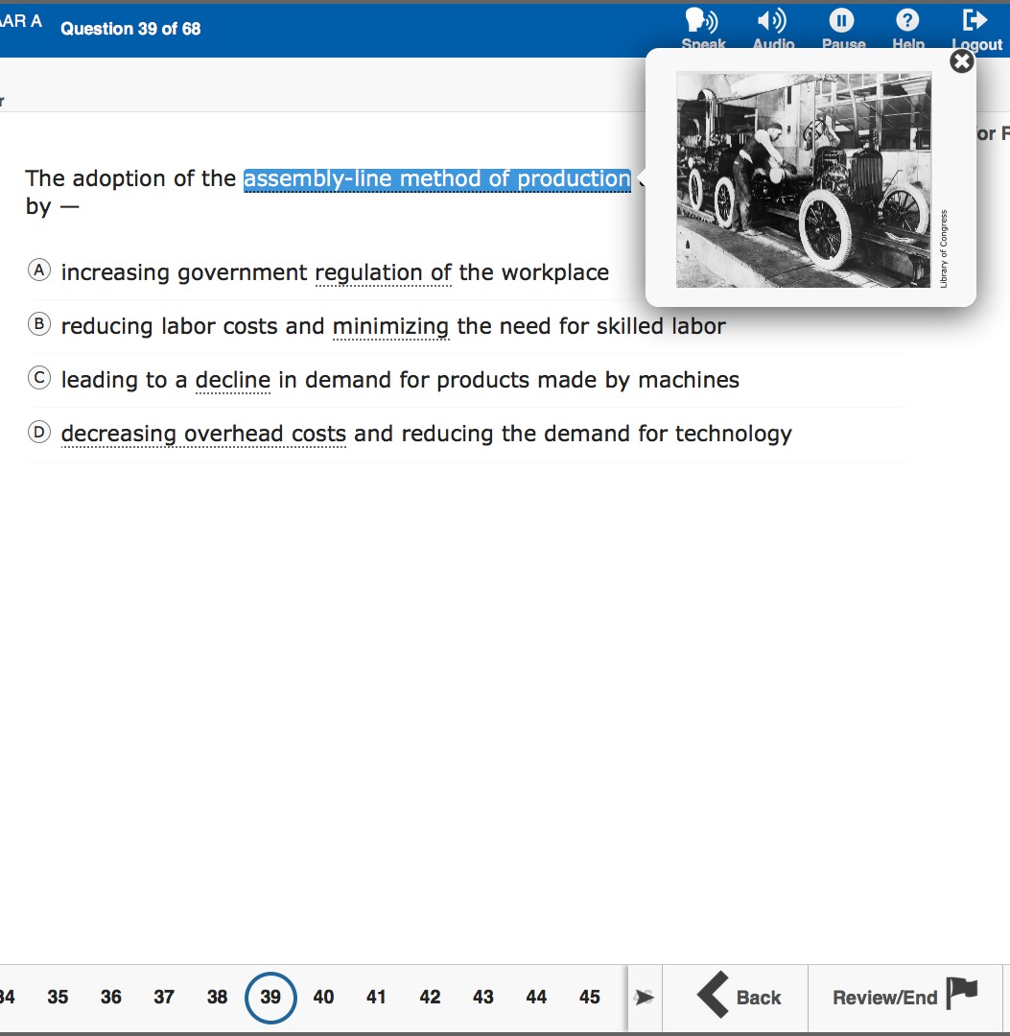
Content and Language Supports
This pop-up provides a visual representation (i.e., photograph) of the vocabulary.

Slide 41
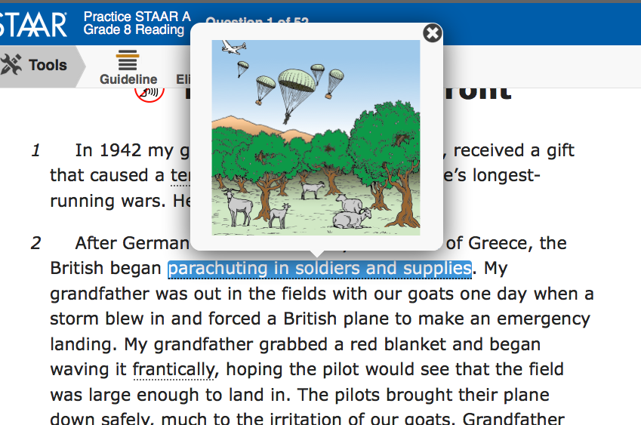
Content and Language Supports
This pop-up also provides a visual representation (i.e., art) of the language in a reading selection.

Slide 42
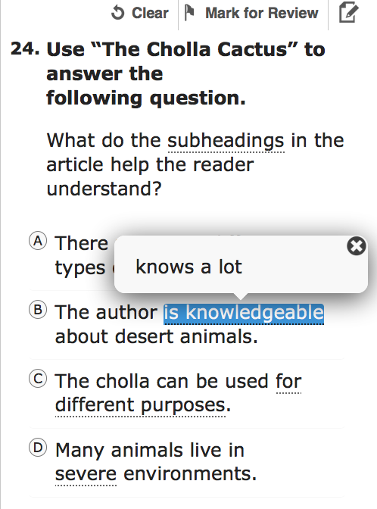
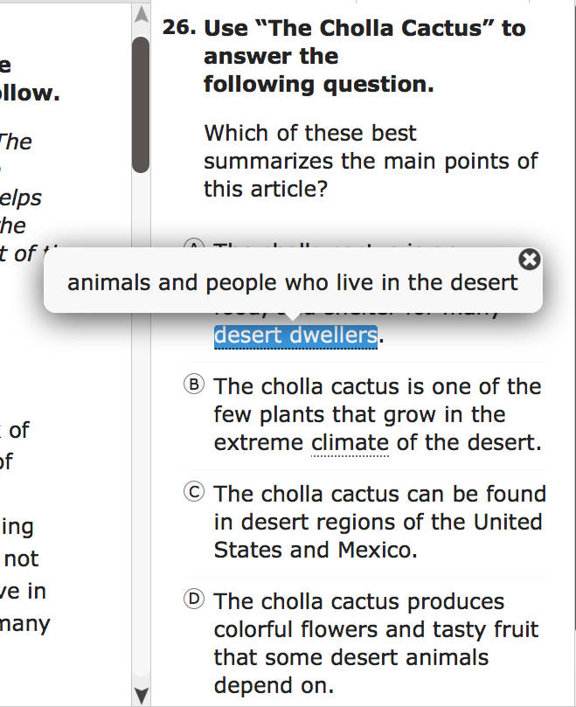
Content and Language Supports
These pop-ups clarify construct-irrelevant words.

Slide 43
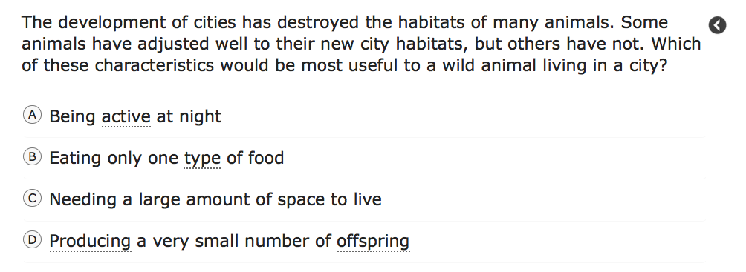
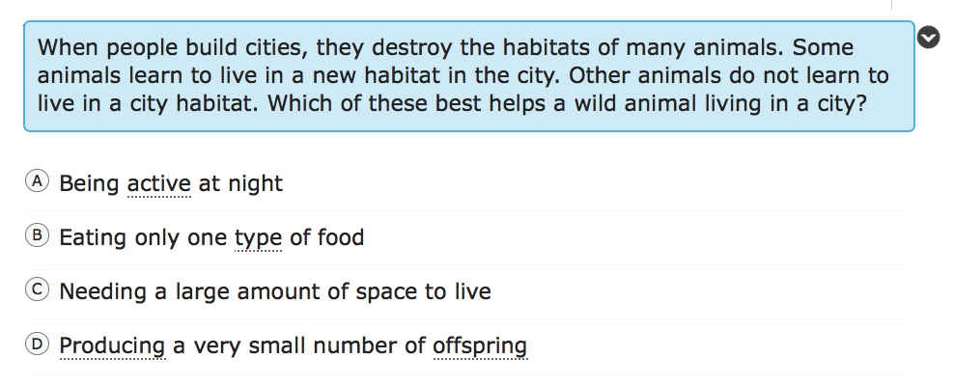
Content and Language Supports
This rollover clarifies text using simpler and consistent language.

Slide 44
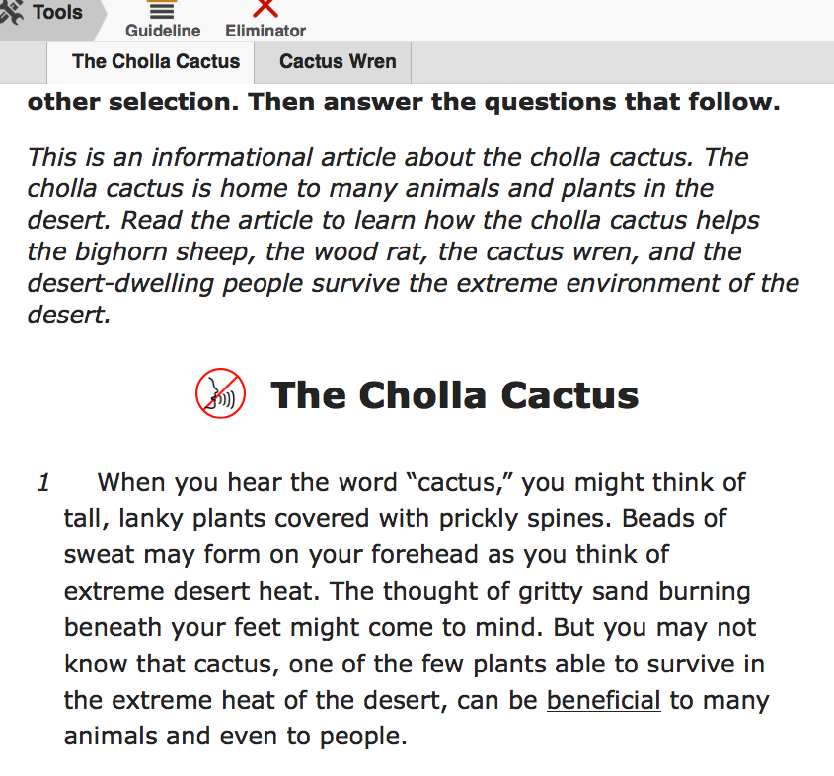
Content and Language Supports
Pre-reading text appears before all reading and writing selections.

Slide 45
3. Oral administration

Slide 46
Oral Administration
Oral Administration
Paper
Online
Text to Speech
Do not document levels
Test administrator
Document levels

Slide 47
Oral Administration
Oral Admin
Content & Language Supports
STAAR Online

Slide 48
What about dictionaries?

Slide 49
Dictionaries
LPACs should also be very familiar with the updated STAAR dictionary policy (Reading/Writing/ELAR) for all students, since it now includes 3rd-5th grades: https://txassessmentdocs.atlassian.net/wiki/spaces/ODCCM/pages/191563472/STAAR+Dictionary+Policy
Remember! The use of bilingual dictionaries can now be found under the accessibility features (Math, Science and Social Studies). Their use DOES NOT have to be documented by the LPAC: https://tea.texas.gov/accommodations/

Slide 50
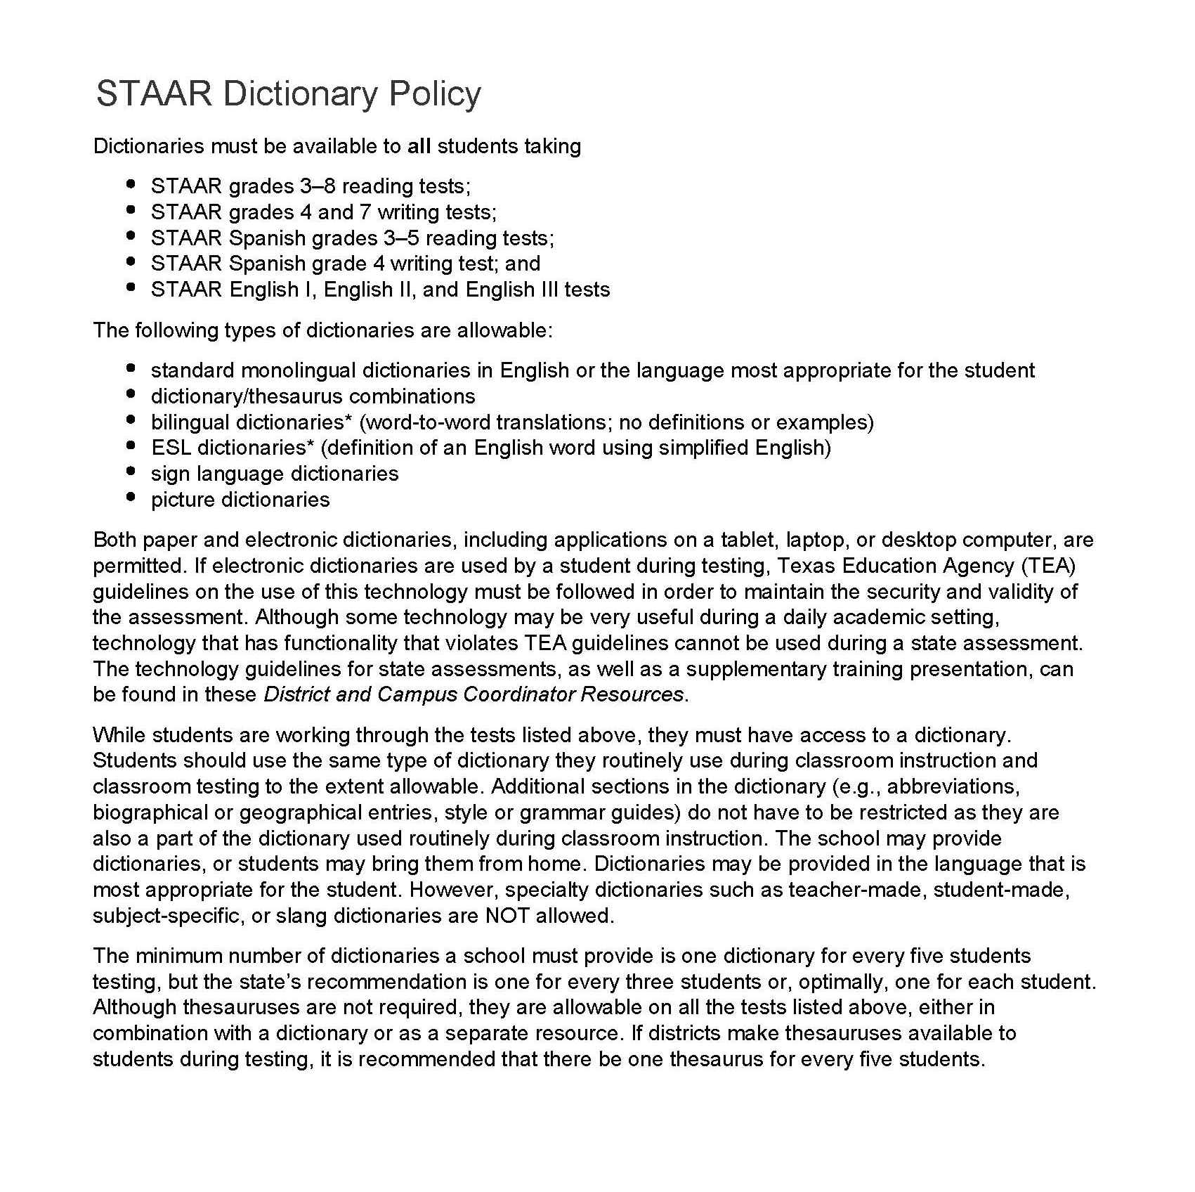
Dictionaries

Slide 51
Online Tutorials and Practice Tests
https://www.texasassessment.com/administrators/technology/

Slide 52
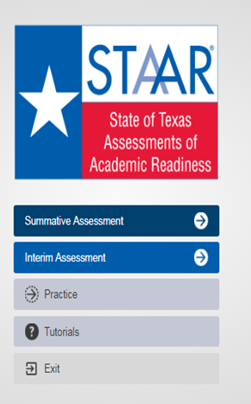
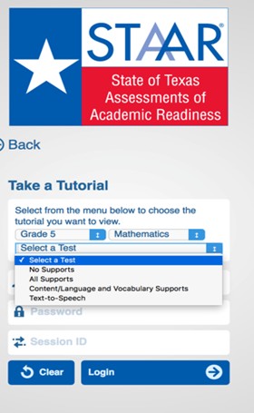
STAAR Online Tutorials
When you open the STAAR online testing platform, you will see a menu of options, including “Tutorials.”

Slide 53
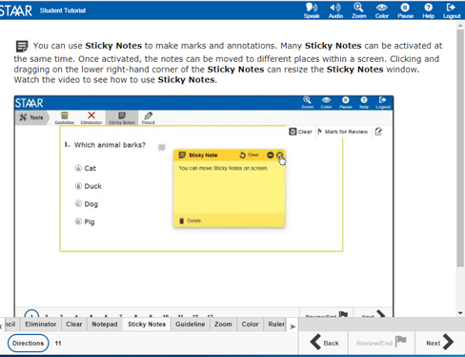
STAAR Online Tutorials
Tabs at the bottom of the screen act as a table of contents. Each tab contains a page that explains the online feature/tool and provides a short video.
Note: Videos do not have sound except for the Speak and Audio videos, which only read aloud the text on the screen.

Slide 54
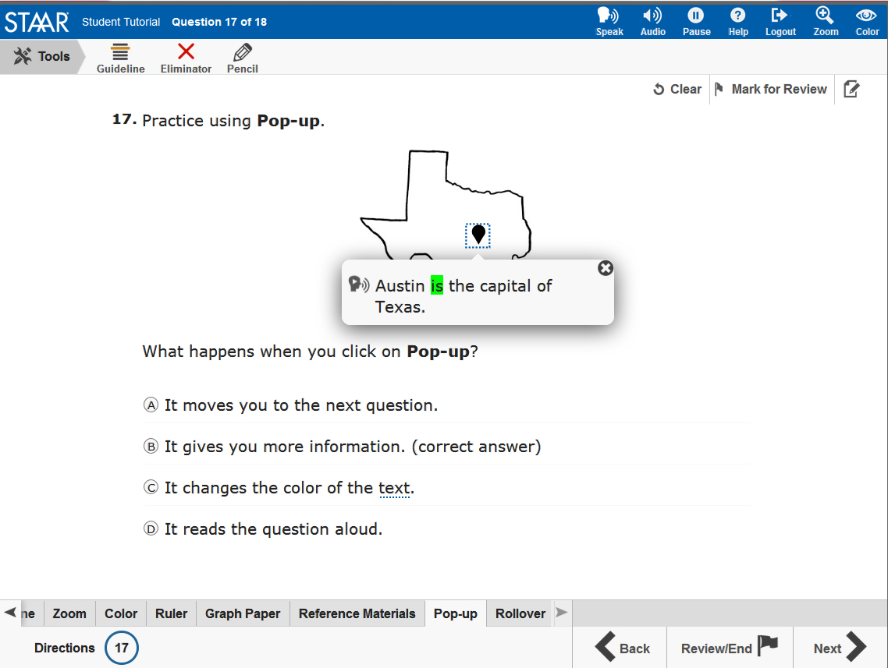
STAAR Online Tutorials
The second page of each tab has a question that you can use to practice with the feature/tool you just learned about.
Note: The questions do NOT contain tested content but are only intended to practice using the feature/tool.

Slide 55

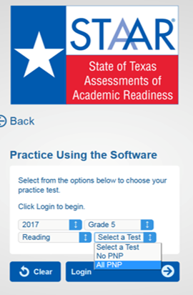
STAAR Practice
When you open the STAAR online testing platform, you will see a menu of options, including “Practice.”
Here you will find released tests for 2017 and 2018.

Slide 56
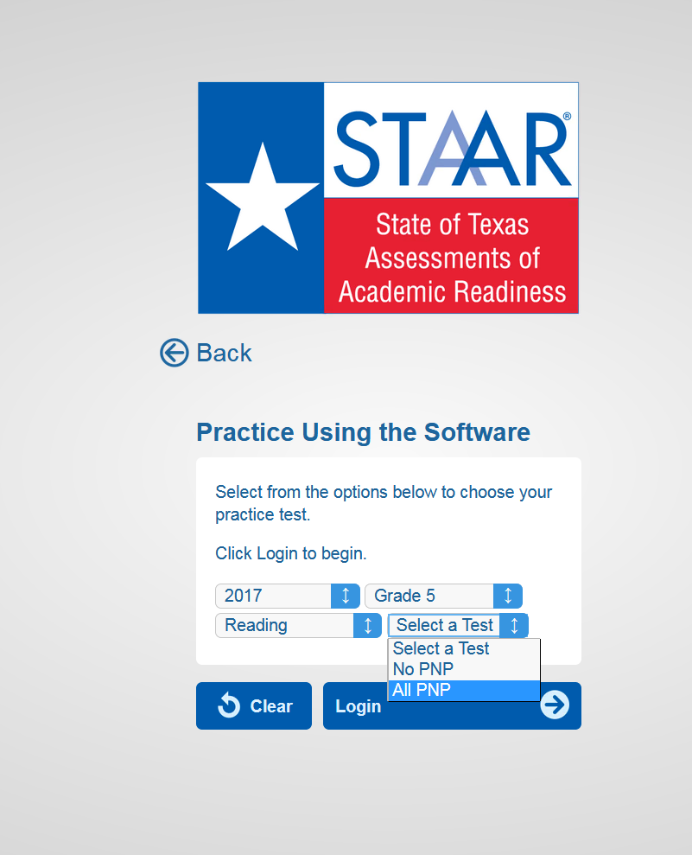
STAAR Practice
To practice taking the test with all supports (i.e., TTS, pre-reads, pop-ups and rollovers), select “All PNP”.

Slide 57

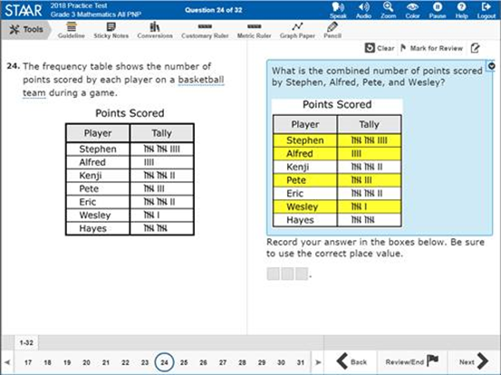

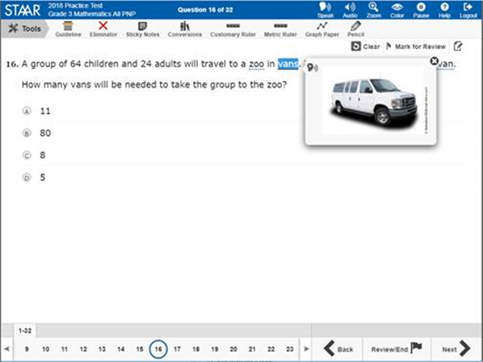
STAAR Online Practice

Slide 58

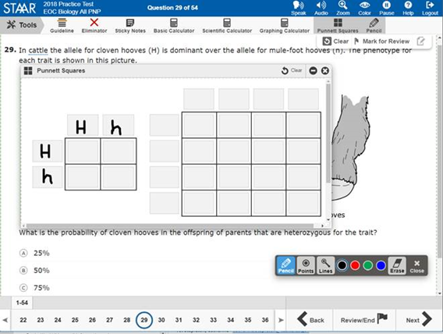

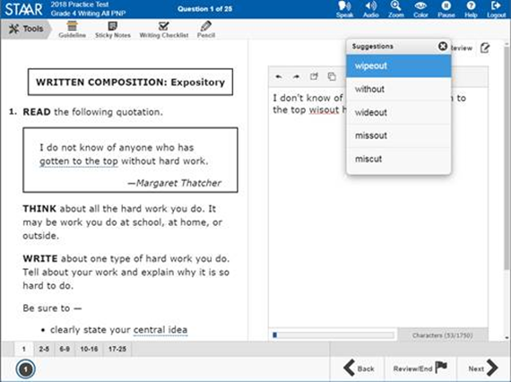
STAAR Online Practice

Slide 59

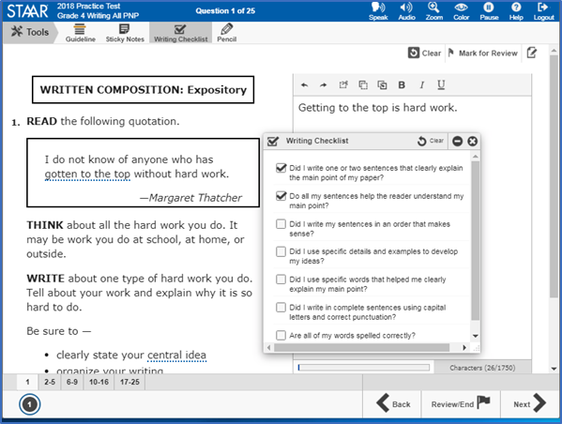

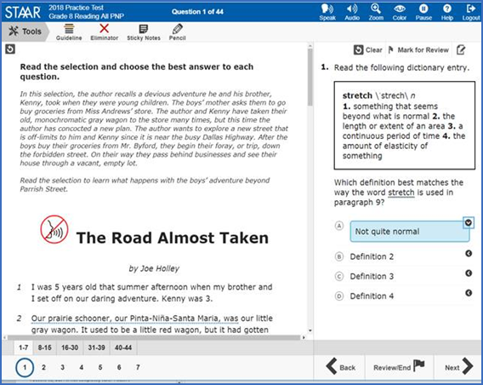
STAAR Online Practice

Slide 60
What is the instructional impact of these changes?
Notes:
Go back to original table and discuss

Slide 61
LPAC Documentation

Slide 62
Session Objectives
Content Objective
Today I explored different designated supports available for ELs on state assessments.
Language Objective
Today I shared with my peers one designated support and I listened to their presentations.

Slide 63
HEAT Framework
High Order Thinking + Engagement + Authenticity + Technology Integration

Slide 64
Session Objectives
Content Objective
Today I will examine the HEAT Framework as a vehicle to increase EL performance.
Language Objective
Today I will read and share with my peers what I learned about the HEAT Framework.

Slide 65
3 Step interview
“It’s the thought
that counts!”
Notes:
Get up and walk around during the song
When the song stops, find a partner
Introduce yourself
Discuss the phrase as it relates to you in an education setting
Be ready to come back to your tables to discuss what you heard (not what you said!)
Guided discussion: The role of the teacher is to develop good thinkers (long-life learners and problem solvers), not just good recipients of information (It’s the THOUGHT that counts)

Slide 66
Turning Up the HEAT!
H : Higher Order Thinking
E : Engaged Learning
A : Authentic Learning
T : Technology
Notes:
Divide participants in four groups and assign each group a letter: H E A T

Slide 67
Circle Map
Black: What I know
Blue: What I learned
from the text
H
Higher Order
Thinking
Red: What I learned from others
Notes:
1. Teachers write in black everything they know about their own category: H. E. A. or T.
2. Then they will read and discuss their category from the HEAT handout; they will add in blue what else they learned about their category
3. Teachers will post their charts and they will add in red what else they know about each category, through a gallery walk
4. Teams come back and debrief to summarize their findings
5. “Person with longest hair on each team stands up… and selects who will debrief the whole class”

Slide 69

Turning Up the HEAT!
Secondary: The Math Trail
Notes:
Click on the link to watch Ms. Toliver’s secondary video and ask participants to evaluate using the HEAT Framework
How could you turn up the HEAT on her lesson (move to the next level)?

Slide 70
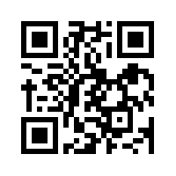
Let’s kahoot!
kahoot.it
create.kahoot.it

Slide 71
How does the HEAT Framework fit into your plans?

Slide 72
Session Objectives
Content Objective
Today I examined the HEAT Framework as a vehicle to increase EL performance.
Language Objective
Today read and shared with my peers what I learned about the HEAT Framework.

Slide 73

Exit Tickets
I used to think…
But now I know…

Slide 74
Thank you for your participation!
See you 03/23
Karina E. Chapa, M.Ed.
Language Proficiency, Biliteracy and Cultural Diversity Director
kchapa@esc1.net
Facebook: Region One ESC Bilingual
Twitter @esc1bilingual @bilingualpride

